Slide 1
Lead Scoring Case Study
Submitted By:
1. Tushar Nayak
2. Sumaiyya Sultana

Slide 2
Problem Statement :
X Education sells online courses to industry professionals. The company markets its courses on several websites and search engines like Google.
Once these people land on the website, they might browse the courses or fill up a form for the course or watch some videos. When these people fill up a form providing their email address or phone number, they are classified to be a lead. Moreover, the company also gets leads through past referrals.
Once these leads are acquired, employees from the sales team start making calls, writing emails, etc. Through this process, some of the leads get converted while most do not. The typical lead conversion rate at X education is around 30%.

Slide 3
Business Goal:
X Education needs help in selecting the most promising leads, i.e. the leads that are most likely to convert into paying customers.
The company needs a model wherein you a lead score is assigned to each of the leads such that the customers with higher lead score have a higher conversion chance and the customers with lower lead score have a lower conversion chance.
The CEO, in particular, has given a ballpark of the target lead conversion rate to be around 79%.

Slide 4
Strategy Steps:
Source the data for analysis
Clean and prepare the data
Exploratory Data Analysis.
Feature Scaling
Splitting the data into Test and Train dataset.
Building a logistic Regression model and calculate Lead Score.
Evaluating the model by using different metrics - Specificity and Sensitivity or Precision and Recall.
Applying the best model in Test data based on the Sensitivity and Specificity Metrics

Slide 5
Problem solving methodology followed
Data Sourcing , Cleaning and Preparation
• Read the Data from Source
• Convert data into clean format suitable for analysis
• Remove duplicate data
• Outlier Treatment
• Exploratory Data Analysis
• Feature Standardization.

Slide 6
2. Feature Scaling and Splitting Train and Test Sets
3. Model Building
•
• Feature Scaling of Numeric data
• Splitting data into train and test set.
• Feature Selection using RFE
• Determine the optimal model using Logistic Regression
• Calculate various metrics like accuracy, sensitivity, specificity, precision and recall and evaluate the model.

Slide 7
4. Result
• Determine the lead score and check if target final predictions amounts to 80% conversion rate.
• Evaluate the final prediction on the test set using cut off threshold from sensitivity and specificity metrics

Slide 8
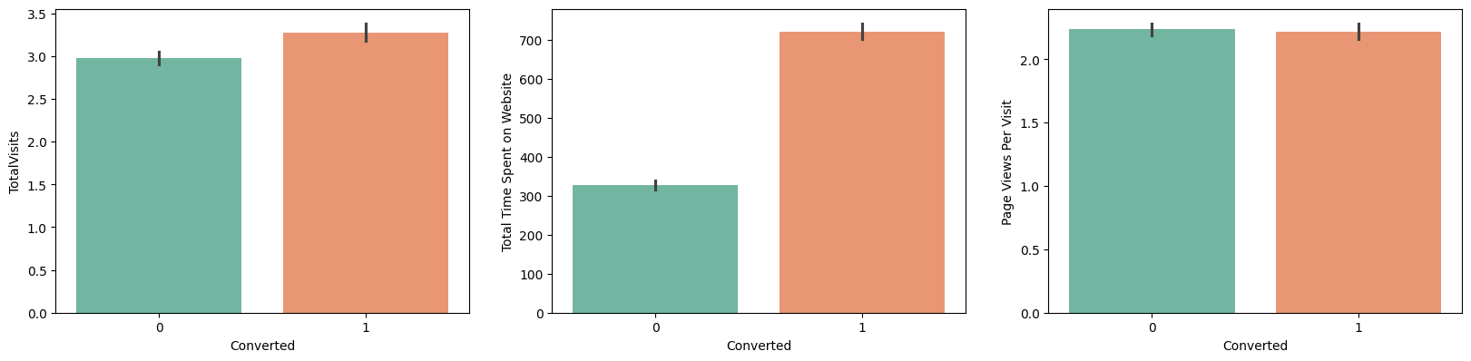
Exploratory Data Analysis
Observation: Total visits, Total Time Spent on Website & Page Views Per Visit was high during analysis.

Slide 9
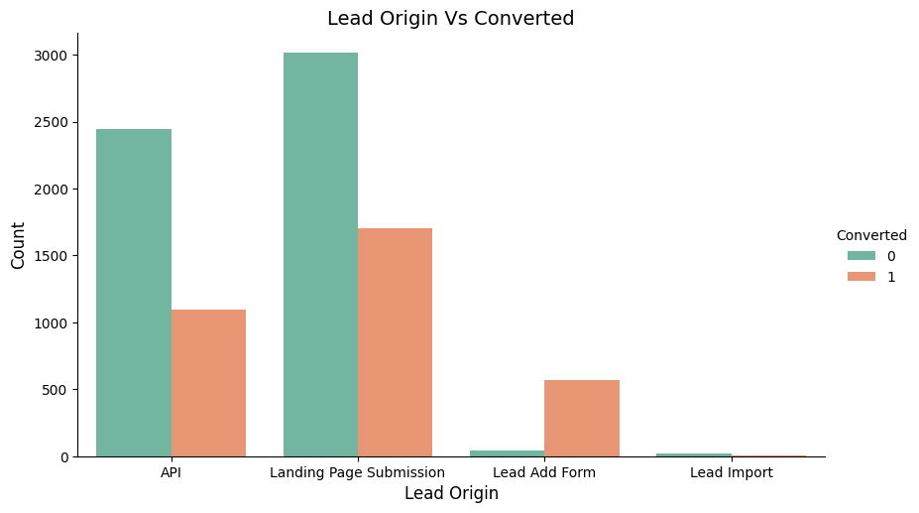
Observation: Maximum conversions happened through landing page submission

Slide 10
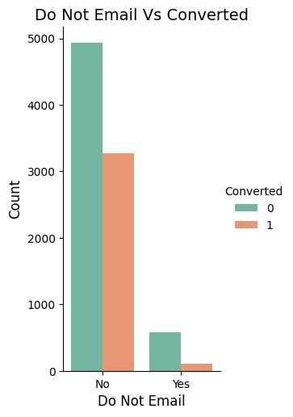
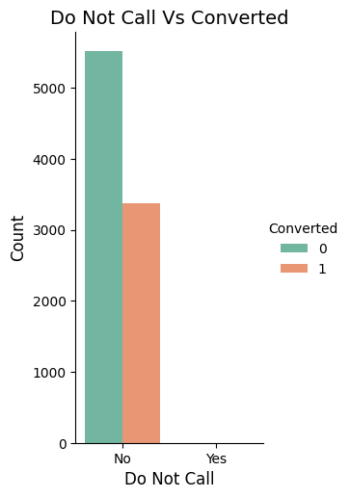
Observation: Most of the conversions happened through email and calls.

Slide 11
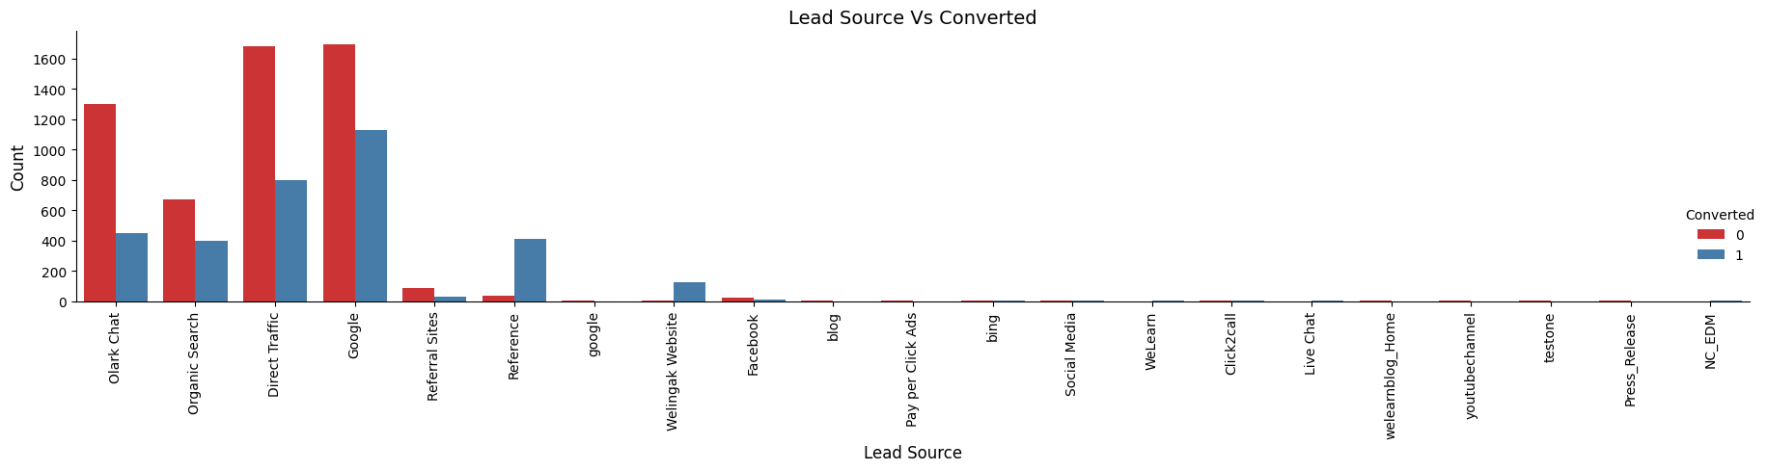
Observation: Most of the conversions was happened through Google.

Slide 12
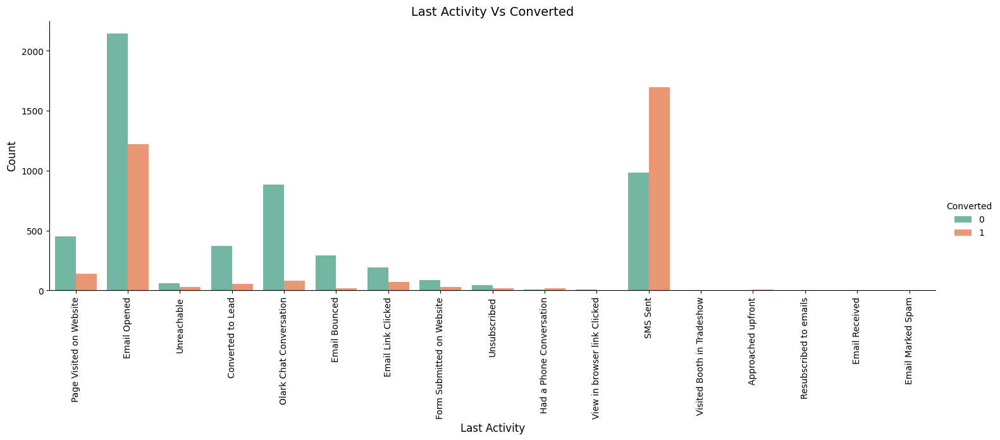
Observation: Most of the conversions was happened through SMS sent last activity.

Slide 13
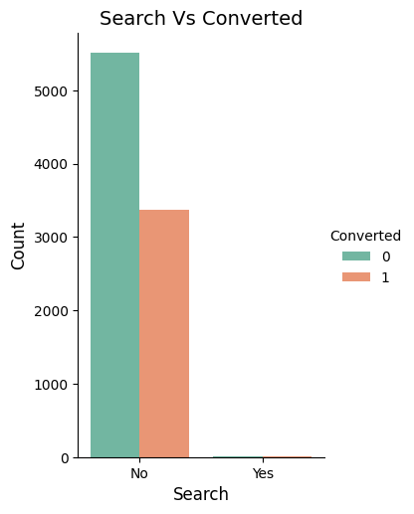
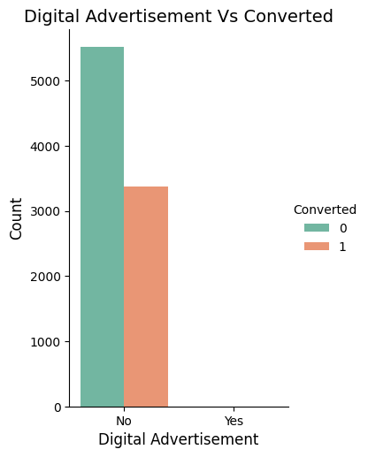
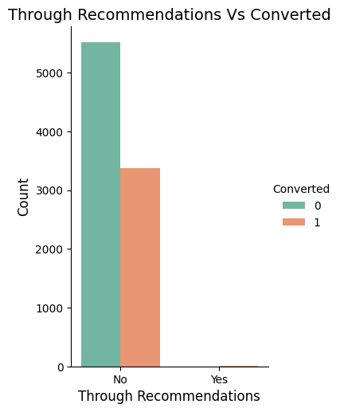
Observation: There is not a huge impact of conversion rates between search, digital advertisement and through recommendations

Slide 14
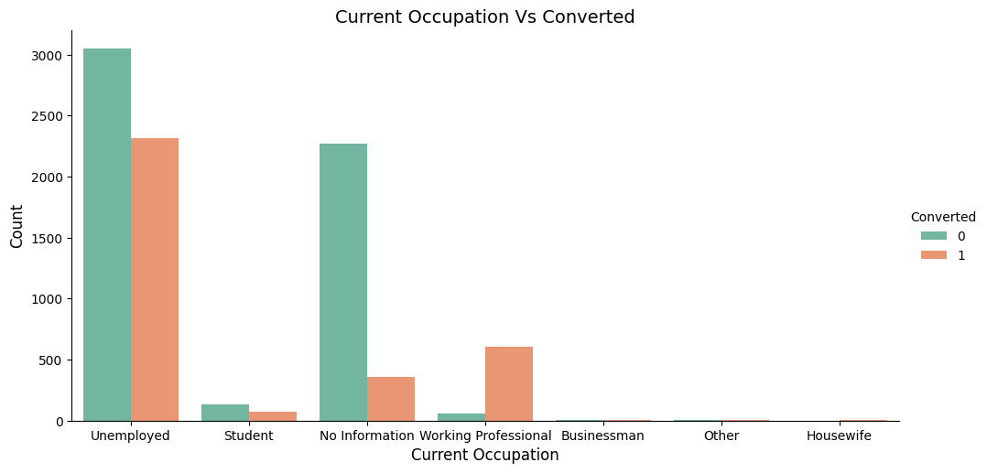
Observation: Most of the conversions was happened with people who are unemployed.

Slide 15
Variables Impacting the Conversion Rate
Total visits
Total Time Spent on Website
Page Views Per Visit
Do not email
Lead Origin – Lead Page Submission
Lead Origin – Lead Add Form
Last Activity – Email Opened
Last Activity – SMS Sent
Current Occupation – Unemployed
Current Occupation – Professional
Last Notable Activity – Email opened
Last Notable Activity - SMS sent

Slide 16
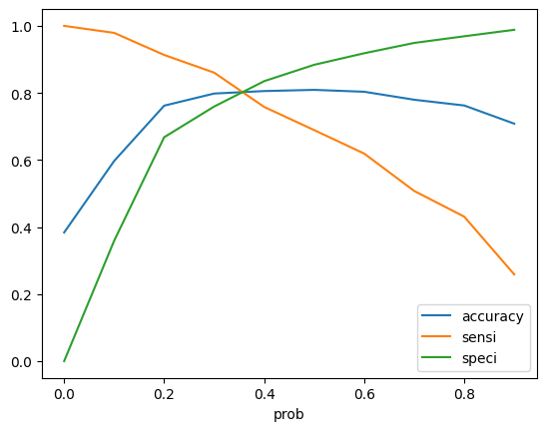
Model Evaluation - Sensitivity and Specificity on Train Data Set
Confusion Matrix
3132 | 700
503 | 1883
• Accuracy - 81%
• Sensitivity - 79 %
• Specificity - 82 %
• False Positive Rate - 18 %
• Positive Predictive Value - 73%
• Negative Predictive Value – 86%
The graph depicts an optimal cut off of approx 0.38 based on Accuracy, Sensitivity and Specificity

Slide 17
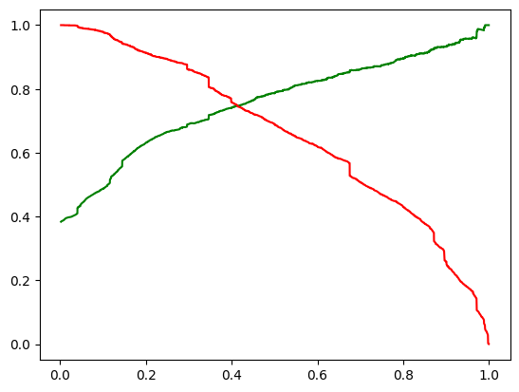
Model Evaluation- Precision and Recall on Train Dataset
Confusion Matrix
3387 | 445
742 | 1644
• Precision - 79%
• Recall - 69%
The graph depicts an optimal cut off of 0.42 based on Precision and Confusion Matrix Recall

Slide 18
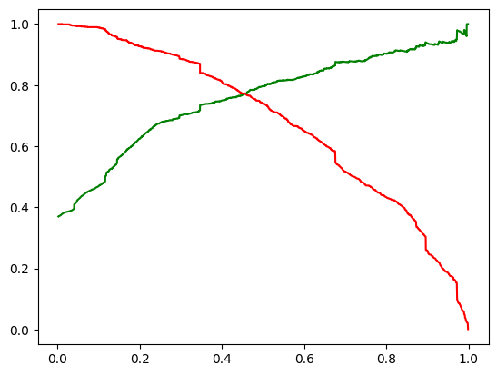
Model Evaluation – Sensitivity and Specificity on Test Dataset
Confusion Matrix
1392 | 288
168 | 817
• Accuracy - 83%
• Sensitivity - 83 %
• Specificity - 83 %
The graph depicts an optimal cut off of 0.42 based on based on Accuracy, Sensitivity and Specificity on Test Dataset

Slide 19
Conclusion
While we have checked both Sensitivity-Specificity as well as Precision and Recall Metrics, we have considered the optimal cut off based on Sensitivity and Specificity for calculating the final prediction.
Accuracy, Sensitivity and Specificity values of test set are around 83% for all which are approximately closer to the respective values calculated using trained set.
Also the lead score calculated shows the conversion rate on the final predicted model is around 79% (in train set) and 83% (in test set)
The top 3 variables that contribute for lead getting converted in the model are
Total time spent on website
Lead Add Form from Lead Origin
Working Professional from Current Occupation
Hence overall this model seems to be good.

